Slide 1
Presentation on Security group and storage in S3
By Goutham S

Slide 2

SECURITY GROUP IN AWS

Slide 3



Security Group :
In this presentation we are going to learn about the below details with examples ..
Introduction
What is security group in aws
How it works
Conclusion

Slide 4
Introduction
Security group are the fundamentals of network security in AWS
Virtual firewall to control both incoming and outgoing traffic to/from AWS resources ( EC2 instance, database, etc..)

Slide 5
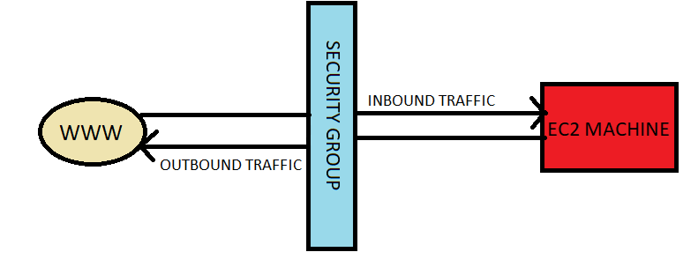
Help you to secure your cloud environment by controlling how traffic will be allowed into your EC2 machines

Slide 6
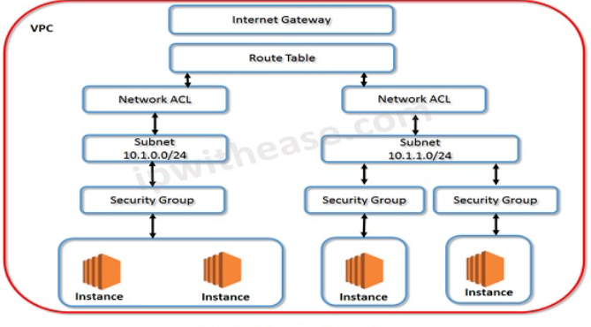
When you launch an instance, you can specify one or more security groups.
If you don't specify a security group, Amazon EC2 uses the default security group
You can add rules to each security group that allow traffic from its mentioned instances
You can modify the rules for a security group at any time.

Slide 7
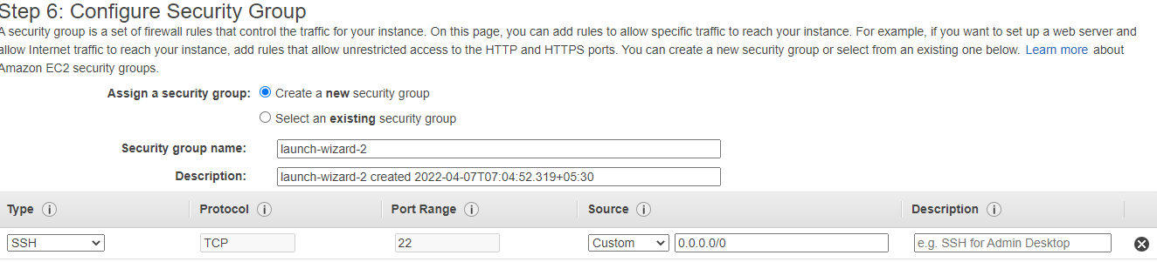
Security groups are like allow/deny firewall rules that we are adding in specific sg ,
In the above pic, we can create a new sg or we can select existing one that we already created with some rules,
What we have creating and adding rules, the same will allow for both inbound and outbound traffic from security group.

Slide 8
Conclusion :
To access Linux machine will use SSH ( Secure Shell ) port range 22,
To access Windows machine will use RDP ( Remote Desktop protocol ) port range 3389,
With Security Groups, you can ensure that all the traffic that flows at the instance level is only through your created ports and protocols.

Slide 9

S3 BUCKET IN AWS

Slide 10

S3 : SIMPLE STORAGE SERVICE
We are going to learn about s3 bucket in AWS with some examples and types .
Introductions
What is S3 Bucket
How it work
What are the types of class in S3
Conclusions

Slide 11

Introductions :
There are three file storage system in AWS,
S3, EBS, EFS
S3 is one of the main storage service in AWS.
S3 commonly used for store the object like jpeg image or html file that anything static ( object based storage )
In this s3 we cant install OS, only we can store file’s
Files need to store as a bucket, and bucket name should be globally unique, A bucket has no limit to the amount of objects that it can store. No bucket can exist inside of other buckets.
If we uploading the object in s3, whether the object is uploaded success or not for that we need to check the status code mention as 200

Slide 12


Slide 13
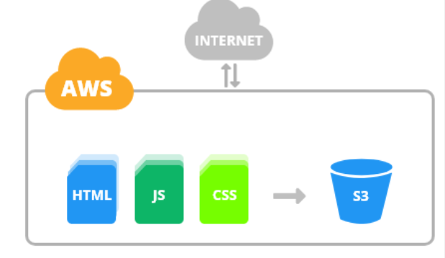
File size limit :
You can store unlimited file size and can vary from 0 bytes to 5tb
There is no storage limit
In this S3, what we have using they same as we pay
At single time we can upload 5gb of file in S3
If we need to upload higher than 5gb, we need to use multipart to add larger file above 5gb

Slide 14
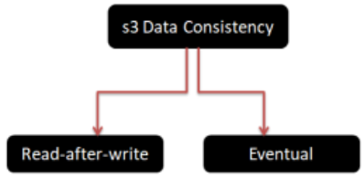
CONSISTENCY MODELS :
Put ( adding new object )in s3 bucket immediately it will available.
Read after write consistency – changes will immediately available.
If we modify or delete the file, changes will take some times to reflect ( its default ).
Read-after-write consistency
Eventual consistency
AWS s3 consistency model started with eventual only. But currently it supports new read-after-write along with eventual consistency.

Slide 15
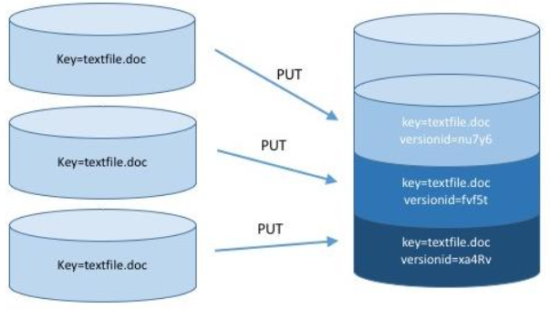
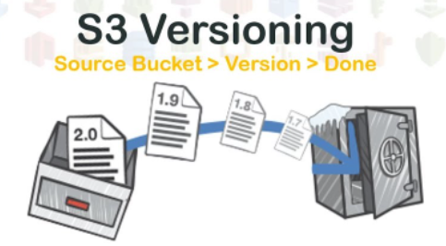
VERSIONING :
Store all versions of the objects
Versioning in Amazon S3 is a mean of keeping multiple variants of an object in the same bucket. You can use the S3 Versioning feature to preserve, retrieve, and restore every version of every object stored in your buckets
In this main drawback is we need to pay for every single versions of the same file.

Slide 16
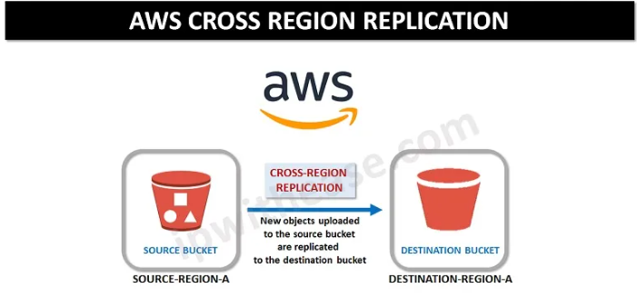
Cross Region Replication :
To replicate object in multiple regions
You can also replicate in same regions
Versioning must be enabled for both source and destination bucket to use cross region replication
Already exiting bucket, we cant apply versioning and cross region replication, but we can do manually
Where we will use the cross region replication, a file can take backup in other location, and already exiting file cant be reflected and if deleted anything it also cant be reflected .

Slide 17

S3 TRANSFER ACCELERATION :
To accelerate uploading file faster, with the help of AWS edge location as below.

Slide 18
Storage Classes :
There are Six types of storage classes in S3..
S3 Standard
S3-IA ( Infrequent Access )
S3 Intelligent Tiering
S3 one Zone- IA
S3 Glacier
S3 Glacier Deep Archive

Slide 19
S3 Standard
By default and most preferred to use is S3 Standard
High durability, high throughput, and low latency
Files uploading and recovering will be reflected immediately
If suppose two region - (AZ) has failure, but S3 standard will available

Slide 20
S3 – IA Infrequent Access
If data that is accessed less frequently, but requires rapid access when needed. S3 Standard-IA offers the high durability, high throughput, and low latency of S3 Standard
S3 Intelligent Tiering
S3 Intelligent-Tiering storage class that delivers automatic cost savings by moving data between two access tiers, frequent access and infrequent access based on each object's access patterns.

Slide 21
S3 one Zone- IA
New storage class designed for customers who want a lower-cost option for infrequently accessed data
But do not require the multiple Availability Zone
S3 Glacier
Glacier, is a low-cost cloud storage service for data with longer retrieval times
And it provides storage for data archiving and backup of cold data

Slide 22
S3 Glacier Deep Archive
Glacier Deep Archive is a storage location for data that will probably not be accessed again, but must be kept in case of a compliance audit or some other business reason.
Storage hardware used for deep archives is usually less expensive and has lower performing options.

Slide 23
Lifecycle Management :
Automates moving your object between different tiers
Can be used with versioning ( Both Current and versions )
You can also configure the lifecycle by using the Amazon S3 console
Retrieve S3 Glacier Archive :
Expedited
Standard
Bulk

Slide 24
S3 to Host Website :
The bucket must have the same name as your subdomain
A Registered domain name, You can use route domain register, or you can use a different register .
S3 Select :
S3 select is an Amazon S3 Feature that makes if retrieve specific data from the contents of an a simple SQL expression without having to retrieve the entire object.

Slide 25
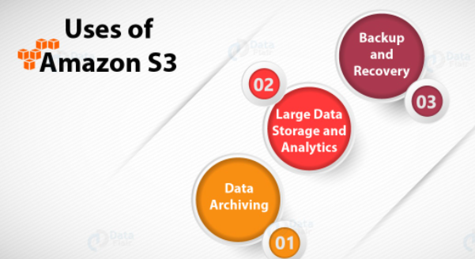
Conclusion :
This are the main things that we can use in the AWS S3.
Thanks for the opportunity to share this presentation …

